Slide 1



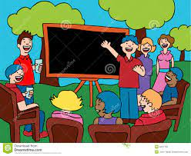








PLAN YOUR GETAWAY!
ACTS OF GENERATIVITY
lifeenjoy.com

Slide 2

GENERATIVITY
PRESENTED BY MITASHI BANSAL A2305219684
RAKSHITA SINGH A2305219691
EKTA GOEL A2305219658
DEVANGNA JAIN A2305219647

Slide 3

OUR MAIN TOPICS TODAY
Introduction to generativity
How does it manifest?
Generativity cycle
What is stagnation
Stagnation vs Generativity
Causes of generativity and stagnation
Benefits of generativity
Consequences of stagnation
How to improve generativity
Decrease stagnation

Slide 4



GENERATIVITY
WHAT IS IT ??
MODERN DAYS VIEWS ON IT
WHAT IS THE STAGE OF THIS

Slide 5


How does it manifest?
Biological Generativity
Technical generativity
Societal Generativity
1.
2.
3.
4.
5.
Parental generativity
Cultural generativity

Slide 6




GENERATIVITY CYCLE
During learning innovation in 4 steps
01
Reflection- taking stock of current benefits and practices
02
Agency – Awakening to a desire to change
Advocacy – trying new strategies to effect change
03
Efficacy – continuing to grow within the ZPD to solve new challenges
04

Slide 7

What Is Stagnation?

Slide 8
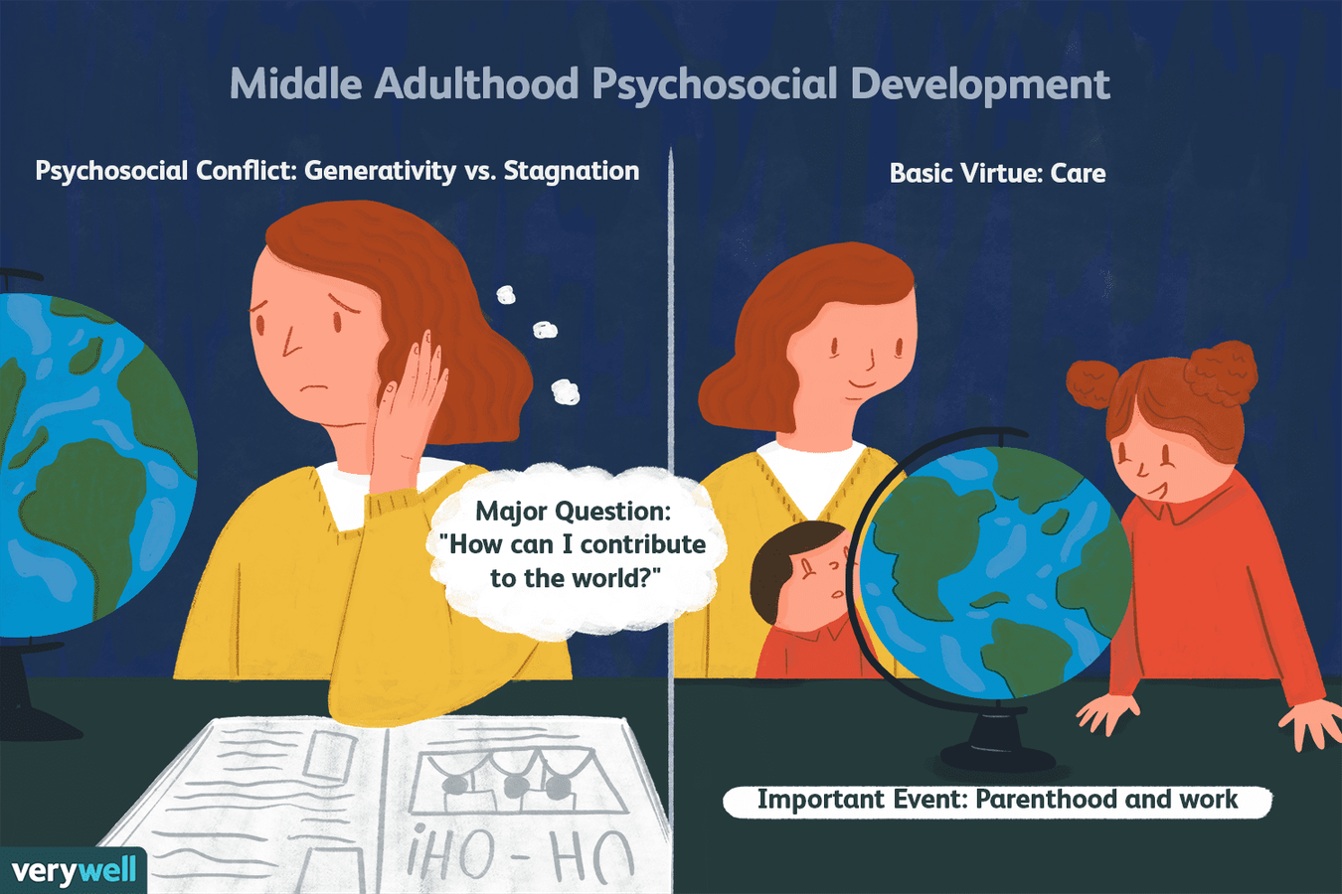
GENERATIVITY VS STAGNATION
Erikson believes generativity encompasses adults’ desire to leave a legacy to the next generation.Through generativity, adults achieve a kind of immortality by leaving their legacy.
Stagnation or self-absorption develops when individuals sense that they have done nothing for the next generation.Through generativity, adults promote and guide those who follow by parenting, teaching, leading, doing things to benefit the community.

Slide 9
STAGNATION
GENERATIVITY
Emphasis on interpersonal values
Focusing on Others(Next generation)
Open to experiences
Creative-Productive tendencies
Emphasis on Instrumental values
Being Self-Absorbed
Closed to experiences
Conservative tendencies

Slide 10




CAUSES
PRIDE IN WORK & FAMILY
TAKING RESPONSIBILITY
FEELING INCLUDED

Slide 11



BETTER HEALTH
BETTER HEALTH
Research suggests that generativity can provide a greater motivation to initiate and maintain healthy behaviors.
INCREASED COMMUNITY INVOLVEMENT
BENEFITS OF GENRATIVITY
GREATER PRODUCTIVITY
The actions required to develop a sense of generativity involve an active participation.
GREATER FULFILLMENT
GREATER PRODUCTIVITY

Slide 12




GREATER FULFILLMENT
Because generativity is focused on making contributions, people who are able to gain this sense of generativity are also more likely to experience a greater sense of fulfillment.
TECHNOLOGY THEN
Presentations are communication tools that can be used as demonstrations, lectures, speeches, reports, and more.
INCREASED COMMUNITY INVOLVEMENT
During the early part of adulthood, parenting and family tend to be the dominant factors contributing to the development of generativity.

Slide 13



Consequences of Stagnation
DECREASED LIFE SATISFACTION
WORSE HEALTH
LOWER QUALITY RELATIONS
SIGNS OF MIDLIFE CRISES

Slide 14
HOW TO IMPROVE
GENERATIVITY

Slide 15
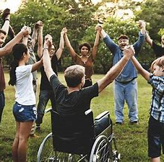
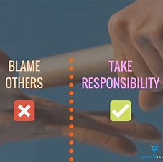


Improve generativity
Quick Wins
Major Projects
Participate in your community
Assume responsibilites
Learn new skills and share them with others
Volunteer
IMPACT
Filler Tasks
Thankless Tasks
TIME & EFFORT

Slide 16
HOW TO DECREASE
STAGNATION

Slide 17

DESCREASE STAGNATION
Learn something new:
Explore a new hobby:
Explore a new hobby:
Learn something new:
DECREASE
STAGNATION
Find new sources of inspiration:
Look for new opportunities:
Find new sources of inspiration:
Look for new opportunities:

Slide 18







THANK
YOU

